Slide 1
Project Title: Python Calculator
Name: Kiran (Ranjan) Ashok Adhav.
Affiliation: NextHikes.

Slide 2
Project Overview:
Here we create a simple GUI python calculator using Tkinter libraries.
Our purpose to create a simple calculator for our users to understand easily how to handle or use simple calculator.
We create simple calculator or user friendly calculator to our users, they can easily understand and calculate simple or regular calculation.

Slide 3
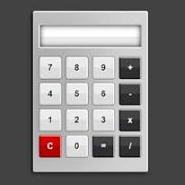
Problem Statement:
Create to solve the simple or understanding calculator for users.

Slide 4
Solution:
A calculator is a machine which allows people to do math operations more easily.
Basic calculators can do addition, subtraction, multiplication and division mathematical calculations.
A normal calculator is like a basic calculator that you use for simple math stuff. It helps you with addition, subtraction, multiplication, and division. It's pretty straightforward and easy to use, with just a few buttons for basic calculations.

Slide 5
Methodology:
Tools :- Python, Visual Studio Code.
Python Libraries :- Tkinter etc.
Tkinter :- Tkinter is the standard GUI library for Python. Python when combined with Tkinter provides a fast and easy way to create GUI Applications. Tkinter provides powerful object-oriented interface to the Tk GUI toolkit.

Slide 6
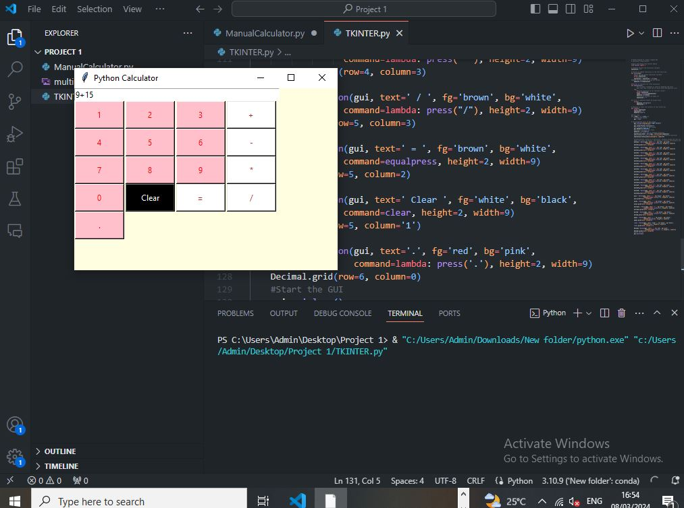
Key Features:-
Provide user-friendly simple python calculator.

Slide 7
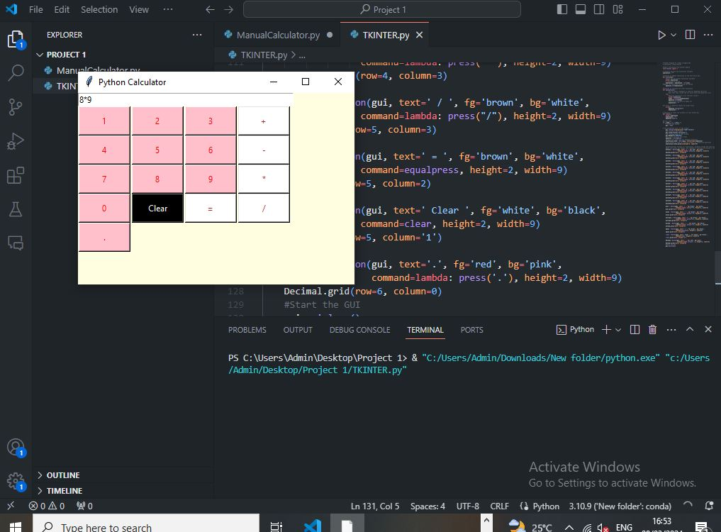
Results And Achievements:-
Out put:-

Slide 8
Challenges Faced :-
Difficult to understand the coding of applications.
We are get difficult to understand Tkinter and GUI.
With the help of https://www.geeksforgeeks.org/python-gui-tkinter/ we can manage to create Simple python calculator.
We understand the language easily and we did R&D with the help of geeksforgeeks.org

Slide 9
Conclusion :-
In this work we have developed a calculator for exact real number computation and performed a theoretical analysis of the algorithms and experimented on their implementation.
A simple user interface has been created to demonstrate the calculator. The interface addresses the problem of allowing the user to view a calculation as it proceeds but also giving an answer which can be used or checked, by outputting signed digits as they are computed and then converting the result into decimal when some specified precision is reached

Slide 10
THANK YOU.

